Slide 1
Easy Finance Application shall be a End-User facing APP where End-Users can Register/Login from their portable electronic devices like pad & phone – iOS & Android.
Req. ID: EFREQ003

Slide 2
EP003
EPIC:
As a BMW prospect I should be able to Register via an APP for Easy Finance Account to Purchase BMW products.
OWNER:
PO (BA)

Slide 3
EP003: Registration
OWNER: PO (BA), Arch (IT), Design
Story ID: EP003-S001-PK:
As a New user to BMW Easy Finance APP I should be able to Register with password for creating a new Account.
Story ID: EP003-S002-PK :
As a New user to BMW Easy Finance APP I should be able to Register with temp. pwd for creating a new Account.
Story ID: EP003-S003-PK :
As a Existing User of Easy Finance Application When I trying to Register with Easy Application Finance, I should be prompted to login.

Slide 4
Story ID: EP003-S001-PK:
OWNER: PO (BA)
Business
Legal
As a New user to BMW Easy Finance APP, I should be able to Register with password for creating a new Account.
Assumptions:
User is at the dealership; APP is not published to APP Store; User do not have a BMW Web (GCDM) Account;
Easy Finance APP to integrate with COP/GCDM;
Pre-Conditions:
Customer can only Download the SF’s Easy Finance APP from the dealership using QR Code shared by the dealer.
APP is Privately hosted and maintained by BMW Financial services.
GCDM Integration for APP user Profile Creation and Management. User Trying to register is not having a BMW GCDM Account.
SMS Trigger is Used for Mobile No. Verification.
Acceptance Criteria:
When the app is downloaded and started, Customer is Prompted with Welcome Page Registration or Login Button
If & when Customer Tap on Registration button from the APP Customer is directed to Registration Page – Possible COP Integration.
Customer Mobile no., Name is Mandatory, since Customer selected “Register with password” Customer is given the option to set PWD.
Customer selects T&C before tapping on send verification code to mobile. 3
Customer need to verify the Mobile with verification code send to customer mobile from the registration page before requesting for Reg.
Customer Data is Synced with BMW’s Global Customer Database Management (GCDM).
Customer is logged in and Lands on APP Home/Main page after successful Registration.
Security
Compliance

Slide 5
Story ID: EP003-S002-PK:
OWNER: PO (BA)
Business
Legal
As a New user to BMW Easy Finance APP, I should be able to Register with password for creating a new Account.
Assumptions:
User is at the dealership; APP is not published to APP Store; User do not have a BMW Web (GCDM) Account;
Easy Finance APP to integrate with COP/GCDM; User have to login with pin in the Next Login.
Pre-Conditions:
Customer can only Download the SF’s Easy Finance APP from the dealership using QR Code shared by the dealer.
APP is Privately hosted and maintained by BMW Financial services.
GCDM Integration for APP user Profile Creation and Management. User Trying to register is not having a BMW GCDM Account.
SMS Trigger is Used for Mobile No. Verification.
Acceptance Criteria:
When the app is downloaded and started, Customer is Prompted with Welcome Page Registration or Login Button
If & when Customer Tap on Registration button from the APP Customer is directed to Registration Page – Possible COP Integration.
Customer Mobile no., Name is Mandatory, since Customer selected “Register with PIN” Customer is not given with option to set PWD.
Customer selects T&C before tapping on send verification code to mobile.
Customer need to verify the Mobile with verification code send to customer mobile from the registration page before requesting for Reg.
Customer Data is Synced with BMW’s Global Customer Database Management (GCDM).
Customer is logged in and Lands on APP Home/Main page after successful Registration.
Security
Compliance

Slide 6
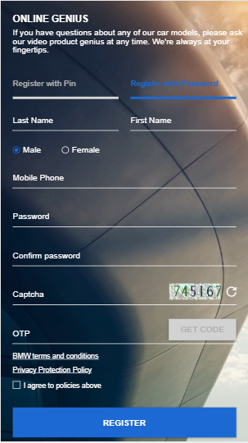
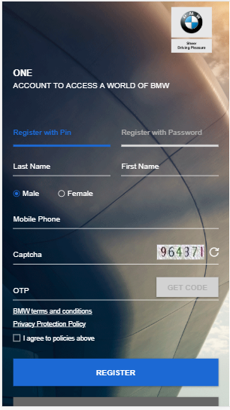
Story ID: EP003-S001-PK & EP003-S002-PK
OWNER: PO (BA)
Mockups:
BMW Financial Services
Welcome!
App Introduction goes here,
Helpline: XX-XXXX-XXX
Congratulations!!!
You are registration is Successful.
Please Click here to understand our Application Process,
Helpline: XX-XXXX-XXX
Login
Registration
Proceed to Application.
Cancel & goto Main Page

Slide 7
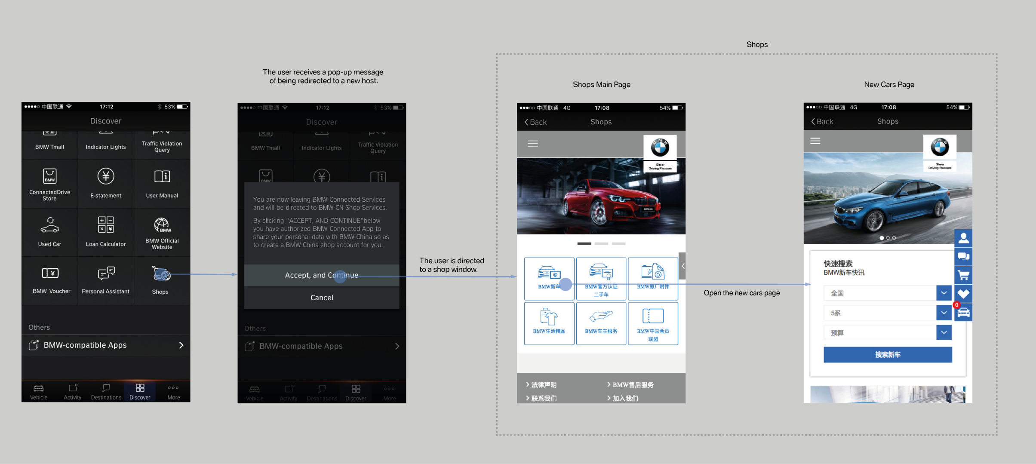
Story ID: EP003-S001-PK & EP003-S002-PK
OWNER: Design
Wireframes
Sample

Slide 8
Story ID: EP003-S001-PK & EP003-S002-PK
OWNER: IT ARCH.
Process Flow:
Easy Finance APP
Registration
Process
User A
Register with PIN
COP
APIGW
GCDM
Redirect (Client_ID, APIKey,
PolicyID, BackURL)
Load COP
Reg. with PIN
Page
Implicit Reg. (APIKey,
Redirect url, Usrname+pwd
Push Data to GCDM
& Create BuPa
Return Access Token
Login Call in Service
Return Success/Failure
Status to API GW
Redirect to
Easy Finance
Main Page
Return (access_token_A),
Set Cookies SMSESSION
User B
Register with PWD
Redirect (Client_ID, APIKey,
PolicyID, BackURL)
Implicit Reg. (APIKey,
Redirect url, Usrname+PIN)
Push Data to GCDM
& Create BuPa
Load COP
Reg. with PWD
Page
Login Call in Service
Return Success/Failure
Status to API GW
Redirect to
Easy Finance
Main Page
Return Access Token
Return (access_token_A),
Set Cookies SMSESSION

Slide 9
Story ID: EP003-S001-PK & EP003-S002-PK
OWNER: IT ARCH.
Sequence Flow
EF APP FE
EF Service BE
COP
APIGW
GCDM
COP Calls GCDM/AIGW
Reg. Services to Complete reg.
APIGW Pushes Customer Profile
Data to GCDM DB.
Redirect to COP With necessary parameters.
COP Passes Successful/Failed
Registration to EF APP & Pass Token
APIGW Passes the responds to COP
GCDM Responds Success/Fail
For Customer Data PUSH
Send the Token to EF Service Backend
Call Login API for
Creating SM session
Pass the token to GCDM API GATEWAY To get validated
Validate and fetch the
data from GCDM DB
Profile Data Returned
Return the Profile Data
Send Success & redirect the customer to Next Step.
Create a Local Copy
& Store in EF DB.

Slide 10
Story ID: EP003-S003-PK:
Business
Legal
As a Existing User of Easy Finance Application When i trying to Register with Easy Application Finance,
I should be prompted to login.
Assumptions:
User is at the dealership; APP is not published to APP Store; User have a Existing BMW Web (GCDM) Account;
Easy Finance APP to integrate with COP/GCDM;
Pre-Conditions:
Customer can only Download the SF’s Easy Finance APP from the dealership using QR Code shared by the dealer.
APP is Privately hosted and maintained by BMW Financial services.
GCDM Integration for APP user Profile Creation and Management. User Trying to register has/had a Existing BMW GCDM Account.
SMS Trigger is Used for Mobile No. Verification.
Acceptance Criteria:
When the app is downloaded and started, Customer is Prompted with Welcome Page Registration or Login Button
If & when Customer Tap on Registration button from the APP Customer is directed to Registration Page – Possible COP Integration.
Customer Mobile no., Name is Mandatory, since Customer selected “Register with PIN” Customer is not given with option to set PWD.
Customer Accepts T&C before tapping on send verification code to mobile.
When the customer tap’s Send Verification code, COP/GCDM Check the GCDM DB and prompts Customer with message saying “ It looks like you already have an account for BMW” – please login with your BMW Web Account.
Will be handled by COP page if integrated with COP.
Security
Compliance

